Slide 1
Wave shape vs Diffusion
Michelle Goodman
20/11/2016

Slide 2
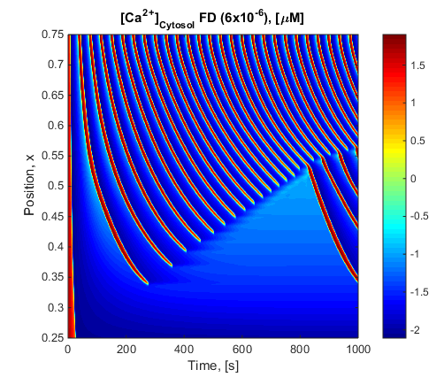
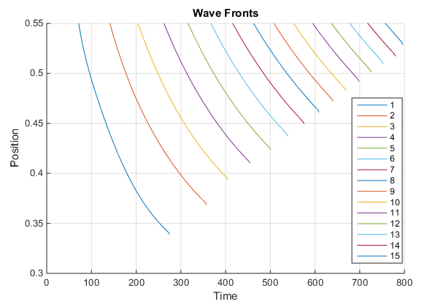
Follow the wave –Toy Model

Slide 3
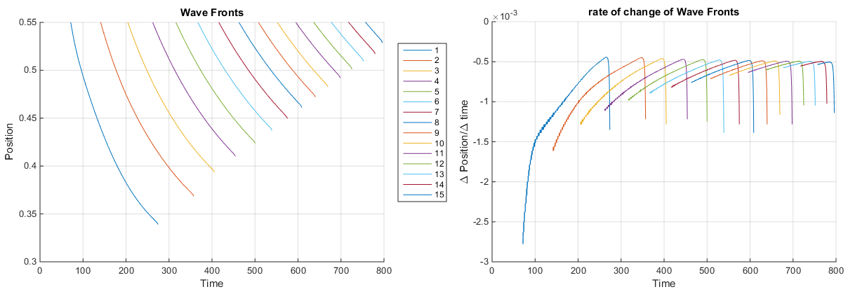
Wave Speed

Slide 4

Notes
Wave 1 doesn’t quite fit to an exponential decay
I am yet to be able to follow wave 16 (The further penetrating wave)
The max wave speed is not quite constant

Slide 5
Re-simulate with Different Amounts of Diffusion For the first Wave Keep track of: Max penetration depth Max Speed

Slide 6
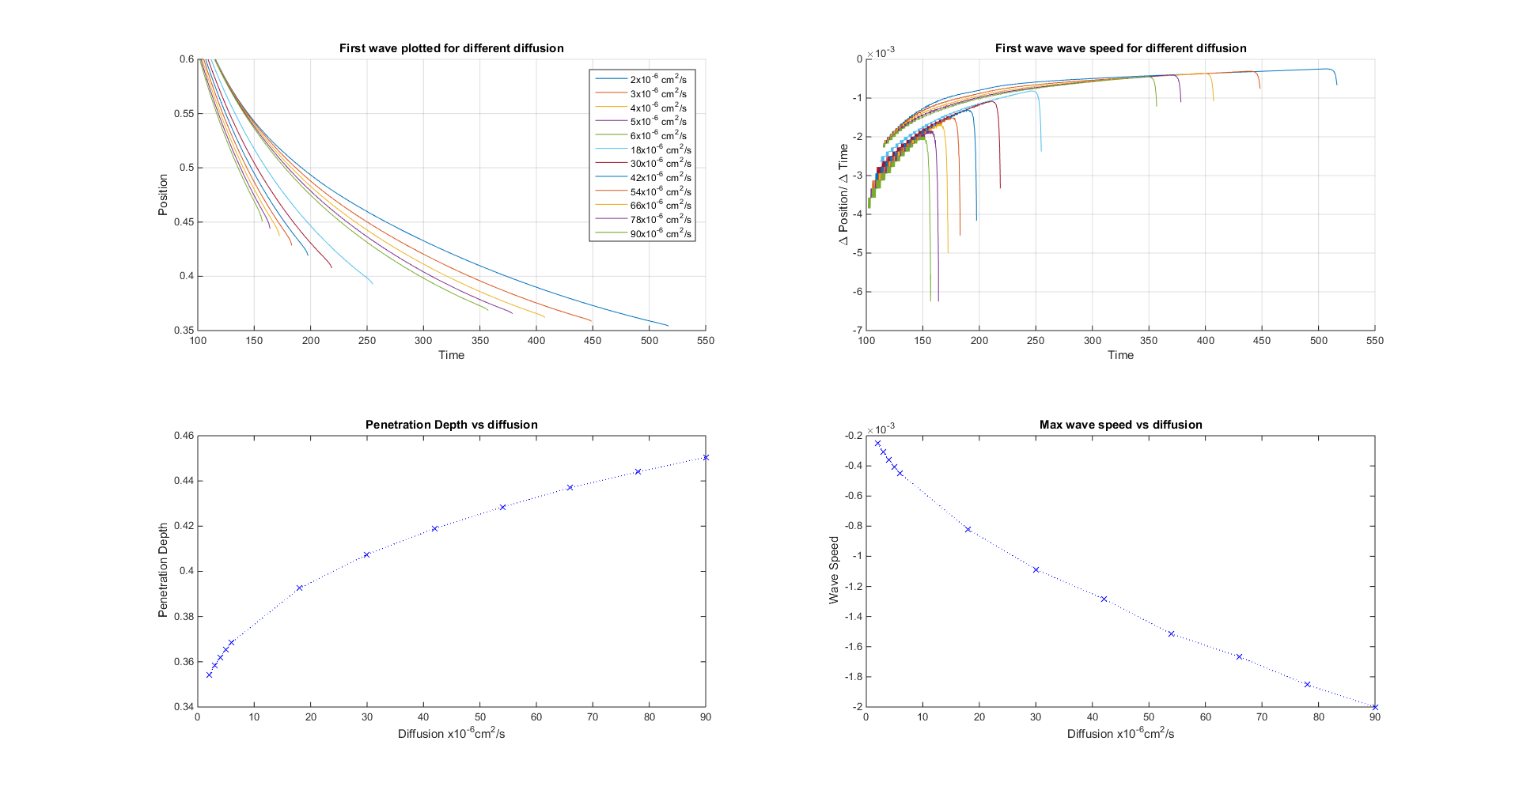
Max Wave Speed vs Diffusion

Slide 7
Penetration Depth Wave 1 vs Diffusion

Slide 8
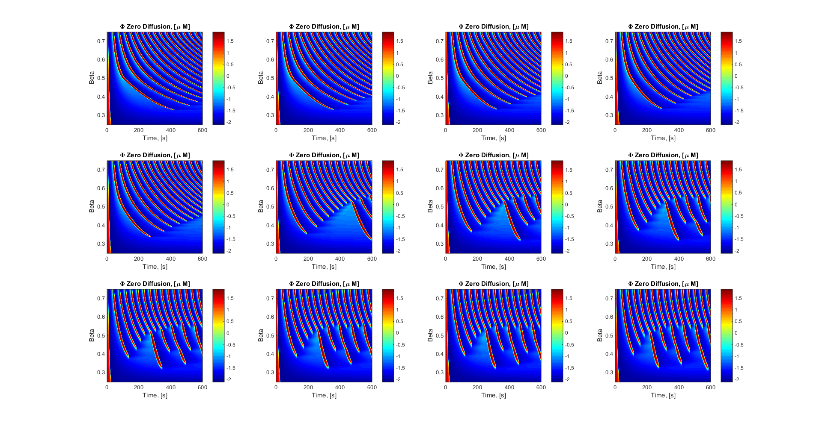
Reason Penetration Depth decreases with Diffusion
Diffusion Grid x10⁻⁶cm²s⁻¹
² | ³ | ⁴ | ⁵
⁶ | ¹⁸ | ³⁰ | ⁴²
⁵⁴ | ⁶⁶ | ⁷⁸ | ⁹⁰

Slide 9
Conclusion
This Toy Model doesn’t follow the trend of increasing diffusion increases penetration of wave 1 because of the interaction of the other penetrating waves

